Slide 1
CPE202/CSC201 Microprocessor Programming Tutorial #2
Dr. Sundaram Suresh
N4-02b-67, School of Computer Engineering
Nanyang Technological University
Email: ssundaram@ntu.edu.sg

Slide 2
Representation
Bit – 1 or ‘0’
8 bits – byte
Word, long word representation is depends on the computer architecture
In general
16 bits – word
32 bits – long word
Why hexadecimal representation?
Notes:
3x12=36 2x12=24 1x12=12 … what 0x12 = 18

Slide 3
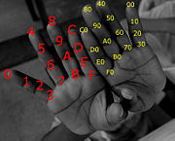
Hand counting of Hexadecimal.

Slide 4
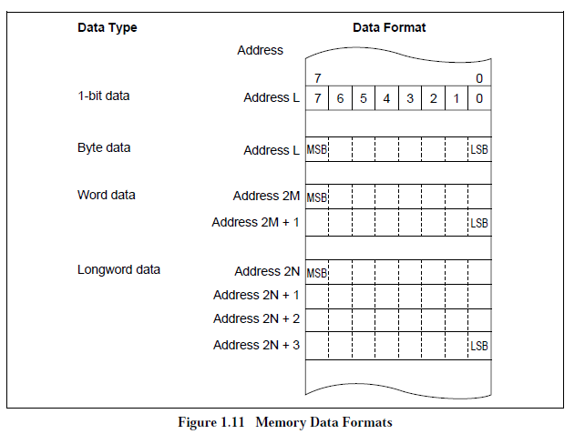
Memory data formats

Slide 5
Power Representation
2^{x} | Value in Hexadecimal
2⁰ | 1
2¹ | 2
2² | 4
2³ | 8
2⁴ | 10
2⁵ | 20
2⁶ | 40
2⁷ | 80
2⁸ | 100
2⁹ | 200
2^{A} () | 400
2^{B} () | 800
2^{C} () | 1000
2^{D} () | 2000
2E () | 4000
2^{F} () | 8000
2¹⁰ () | 10000

Slide 6
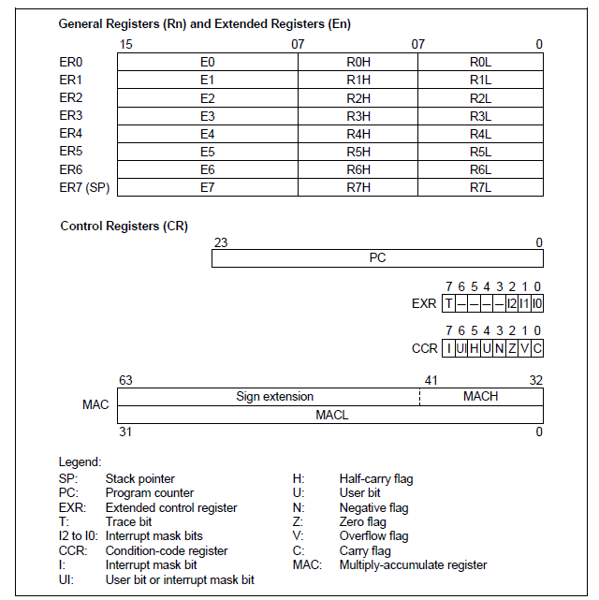
HS8/2000 Register

Slide 7
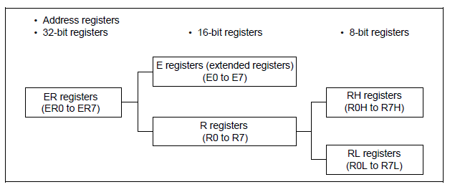
Register…
8 32-bit register (ER0 to ER7)
It can be divided 16 (E0 to E7 and R0 to R7) 16-bit register
Extended register can be further divided into 16 8-bit register as RH0-RH7 and RL0-RL7.
ER7 – function as a stack pointer
General register division

Slide 8
Control Register
Program Counter
This 24-bit counter indicates the address of the next instruction the CPU will execute.
The length of all CPU instructions is 16 bits (one word) or a multiple of 16 bits, so the least significant PC bit is ignored.
When an instruction is fetched, the least significant PC bit is regarded as 0.
Condition-Code Register
This 8-bit register contains internal CPU status information, including an interrupt mask bit (I) and half-carry (H), user bit (U), negative (N), zero (Z), overflow (V), and carry (C) flags.
Extended Control Register
This 8-bit register contains the trace bit (T) and three interrupt mask bits (I2 to I0).
Bit 7—Trace Bit (T):
When this bit is cleared to 0, instructions are executed in sequence.
When this bit is set to 1, a trace exception is generated each time an instruction is executed.
Bit 6 to 3: Reserved (always read as 1)
Bits 2 to 0—Interrupt Mask Bits

